Slide 1
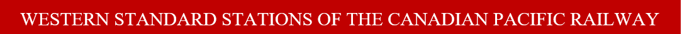
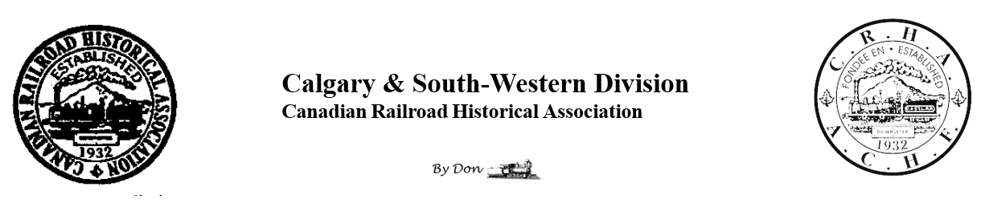
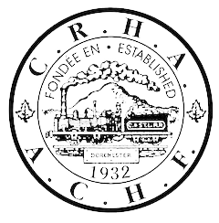
This presentation features “Western Standard Stations of the Canadian Pacific Railway.”
We hope you find it interesting and enjoyable.
- Don Thomas

Slide 2
For the modeler, we hope this look at CPR building practice encourages modeling of a wider range of structures with a genuine “CPR look”.
We hope to encourage others to learn more about stations and railway structures, and to share their knowledge.

Slide 3
CP has owned hundreds of stations throughout its existence.
Many stations were built to standard plans, reflecting contemporary management needs and architectural practices through different eras.
Standardization benefited the company throughout its history.
This was not always achieved with stations due to the large number of “standard” station plans created.

Slide 4
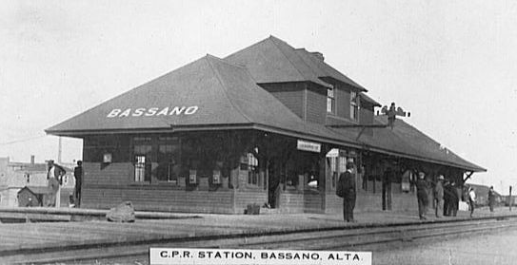
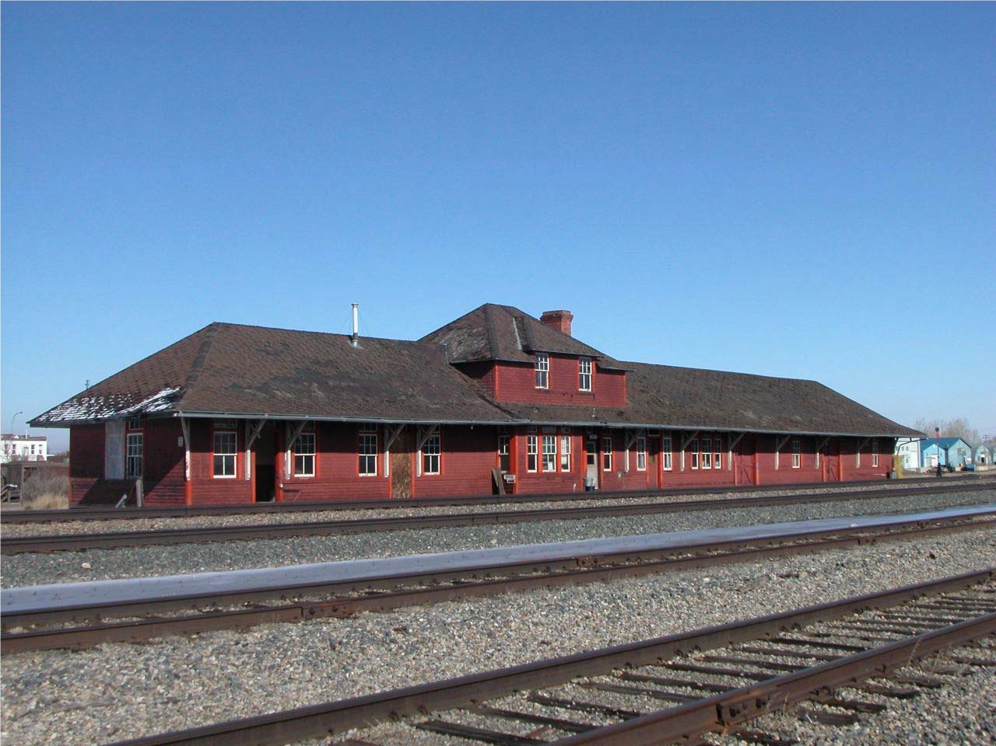
Standard plans differed between east and west, and were replaced periodically by newer designs.
Each design could be extended with additional waiting areas or freight and express rooms to accommodate the traffic at their location.
Bassano station before and after several extensions, after it became an important junction:

Slide 5
Documenting stations can be challenging:
CP’s Eastern and Western Lines had separate Engineering departments, each with its own designs for standard stations.
Some western standard drawings were not preserved because CP’s Archives wasn’t aware that the plans differed from those in the east.
Many stations are not to standard designs, or have no known plans at all.

Slide 6
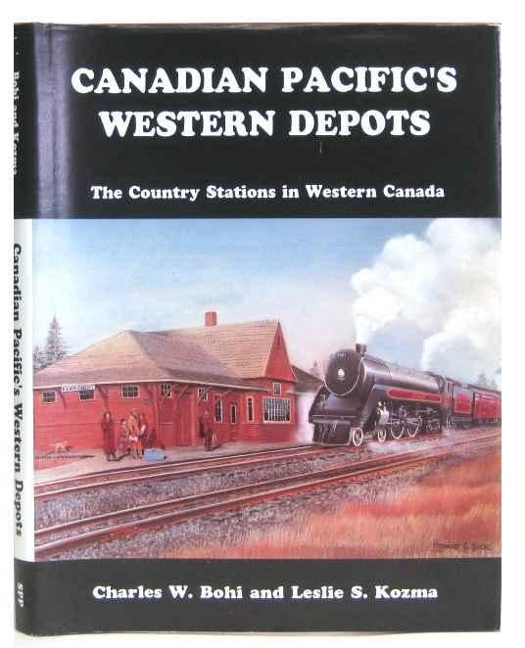
Charles Bohi and Les Kozma created a useful classification of Western Lines stations which is cited in this presentation.
They assigned their own numbers to station designs, which differ from those used by CP.

Slide 7
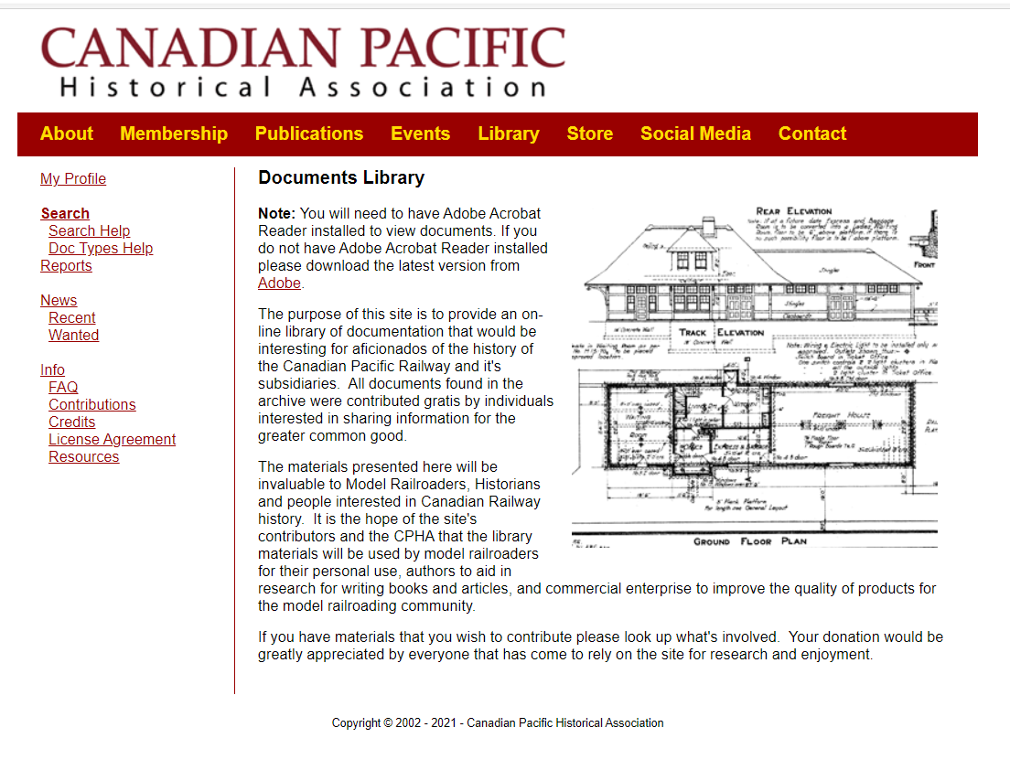
Many Eastern and Western Lines station plans are accessible on the CP Tracks website.

Slide 8
First, a quick review of the many functions a station must serve:
Passengers
Usually baggage
Typically express
Frequently less-than-carload freight
Often staff accommodations
Sometimes maintenance or administrative offices

Slide 9
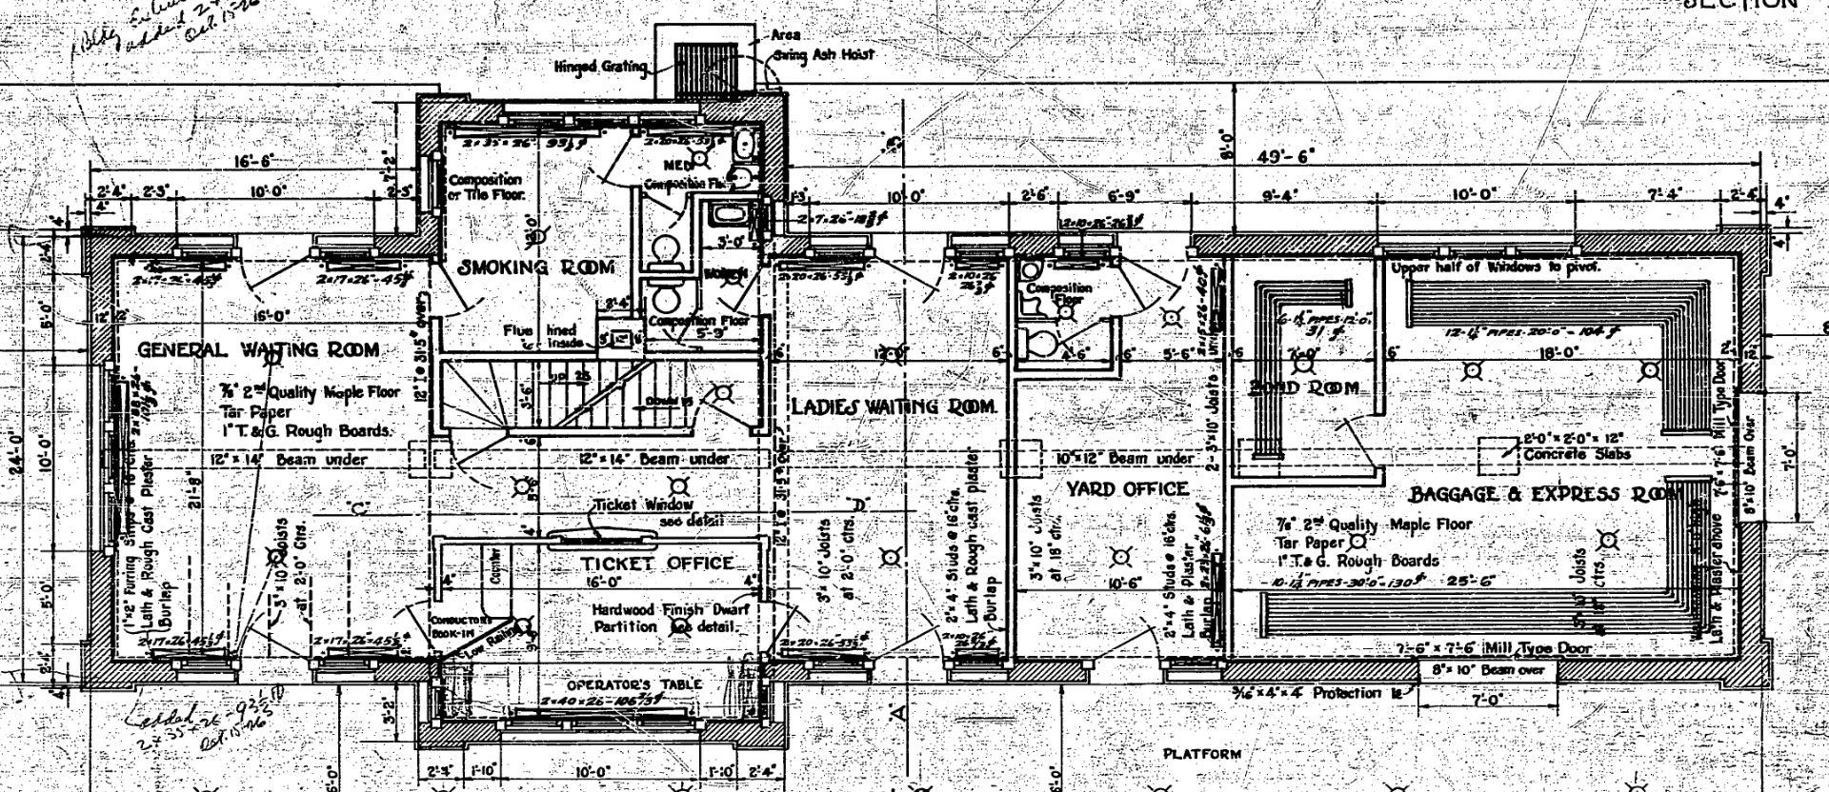
Requirements: Waiting Rooms
At one time larger stations often had multiple waiting rooms:
One general waiting room, one for ladies, and sometimes a smoking room for men.

Slide 10
Requirements: Waiting Rooms
At one time larger stations often had multiple waiting rooms:
One general waiting room, one for ladies, and sometimes a smoking room for men.

Slide 11
Requirements: Waiting Rooms
At one time larger stations often had multiple waiting rooms:
One general waiting room, one for ladies, and sometimes a smoking room for men.

Slide 12
Requirements: Waiting Rooms
Where passenger volume was low, some waiting room spaces were devoted to other functions.
One station design might have different layouts depending on the volume of traffic.

Slide 13
Requirements: Staff Living Space
Stations in small towns or country areas included living space for the agent and his family or staff. Typically these had a second story with living quarters.
Lodgings were easier to find in larger towns, so one-story stations were more common there.

Slide 14
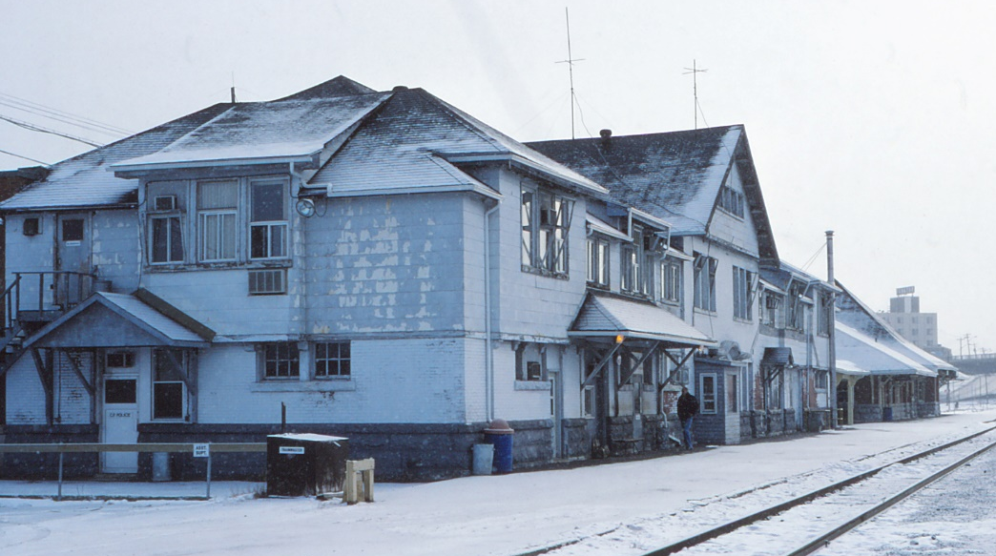
Requirements: Office Space
Division point stations had large office space upstairs, or sometimes in a separate building.
Sudbury
Orangeville

Slide 15
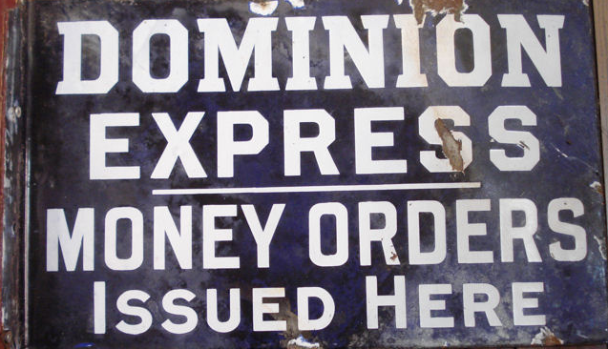
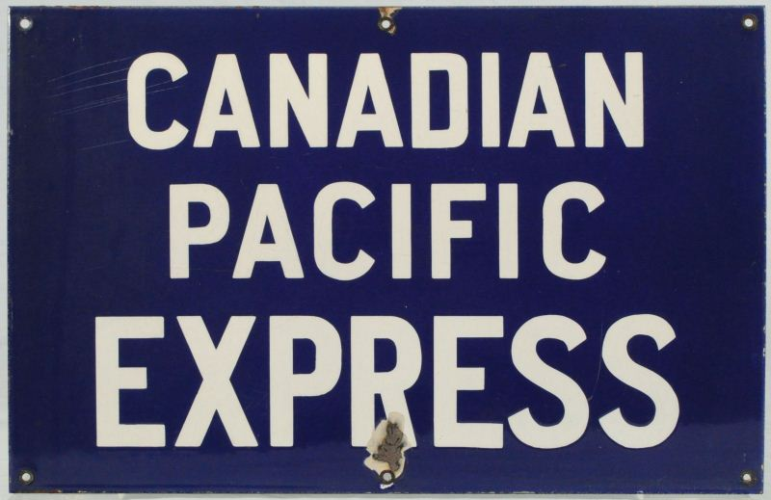
Requirements: Baggage & Express
Most stations needed space for baggage and for express parcels.
Many handled less-than-carload (LCL) freight.
These functions required one, two or three rooms depending on the amount and mix of traffic.

Slide 16
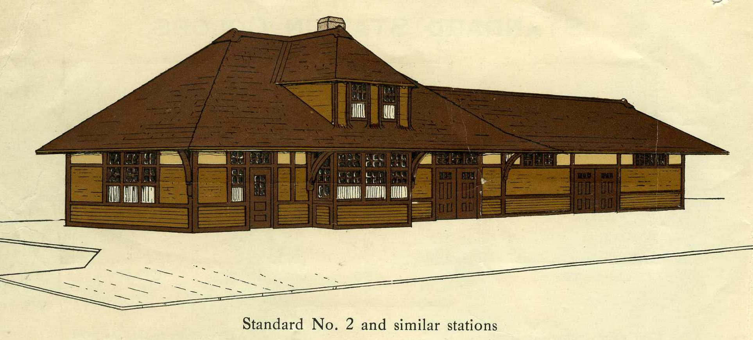
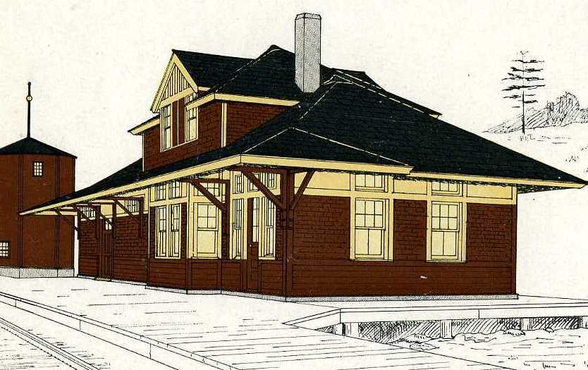
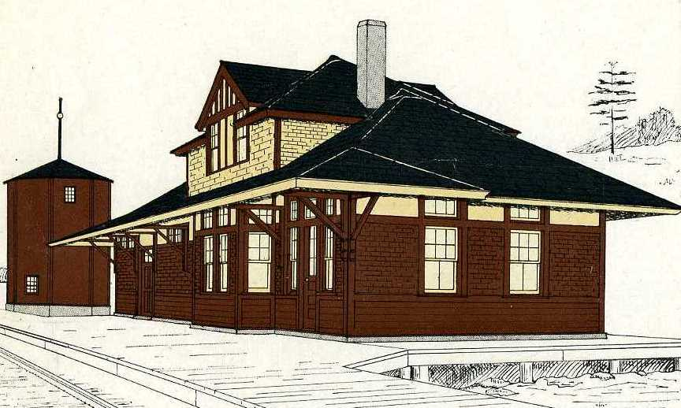
Station Colours
The official 1915 colour scheme (left) for structures called for brown to the tops of window and door openings, and yellow ochre above them and between transom windows.
In 1917 a redder brown was specified, and upper stories could be painted yellow ochre.

Slide 17
Colour Changes Over Time
By the 1950s, CP increasingly painted the walls of its stations mineral red, with window and door frames a light ochre.
Window and door frames of many stations were eventually painted brown or red as well.
There were many exceptions to these trends.

Slide 18
Exterior Siding
Most CP stations were built with conventional wood siding. Brick and stone were reserved for special structures in larger towns and cities.

Slide 19
Exterior Siding
In the 1950s, CP applied protective or insulating cladding to many stations. The most common was InsulBrick or a similar product, which imitated red brick. This material picked up dirt as it aged.

Slide 20
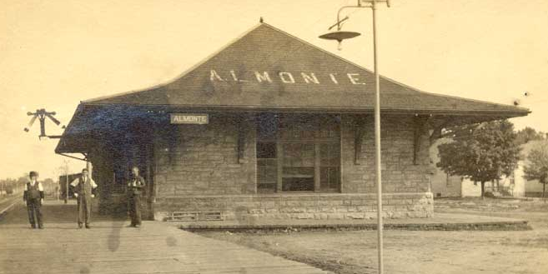
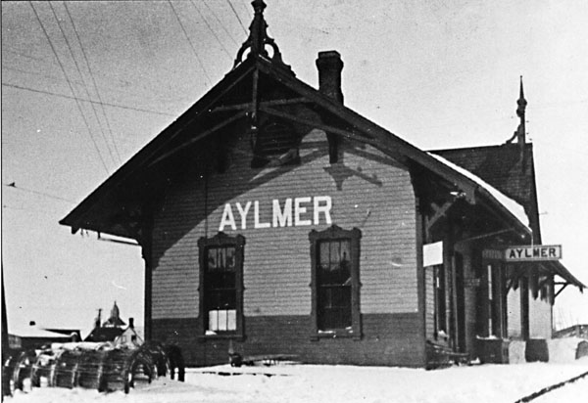
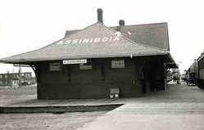
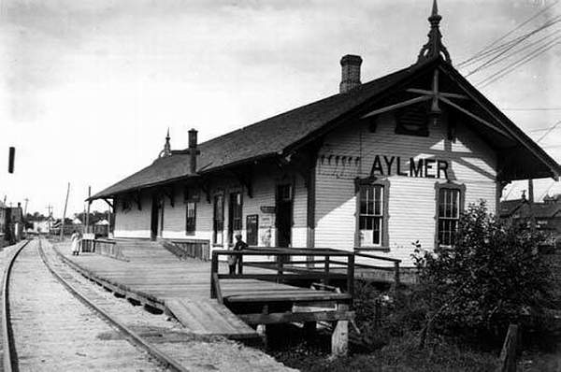
Making the Station Name Visible
For much of the early Twentieth Century, some railways painted station names on the end gables or hip roof of stations. This is a key feature for establishing a station’s era, as well as its name.

Slide 21
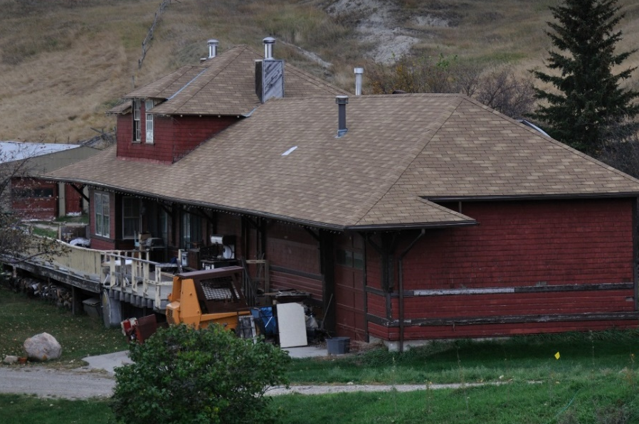
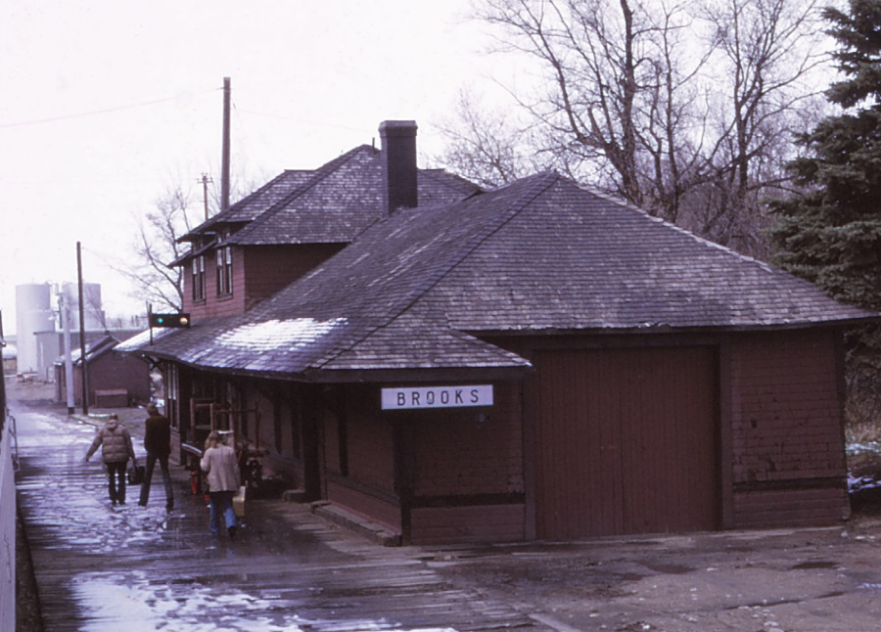
On many CP stations, the eaves were wider on the track side than on the others.
The wider eaves wrapped around the corner, then stopped, leaving a jagged projection as on the stations at Granum and Brooks AB.
Granum
Brooks

Slide 22
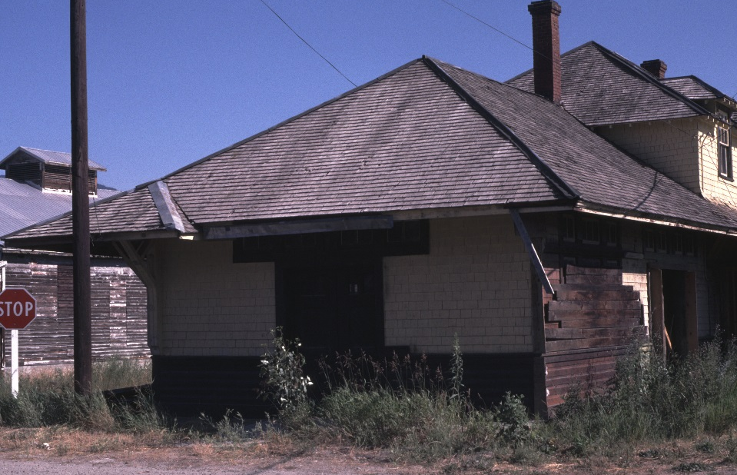
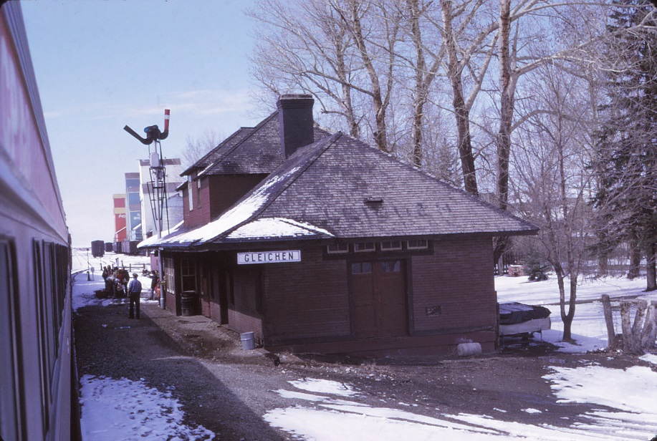
Other stations had wide eaves on all sides, with a flare facing the track to provide extra width.
These, as at Erickson BC and Gleichen AB, had triangular projections at the corners.
Erickson
Gleichen

Slide 23
All Aboard
Join us on a tour of CP stations through time and across western Canada.

Slide 24
Type 1: The “Van Horne” Station
CP’s first standard station design was adopted from other railways.
It was previously used in the Midwestern U.S. and in southern Ontario.

Slide 25
Type 1: The “Van Horne” Station
The design was brought to CP by General Manager William Van Horne, who was familiar with them from previous posts on the Milwaukee Road and Southern Minnesota RR.

Slide 26
Type 1: The “Van Horne” Station
CP built these stations from Ontario to British Columbia.
Most were eventually replaced by larger structures as traffic increased.

Slide 27
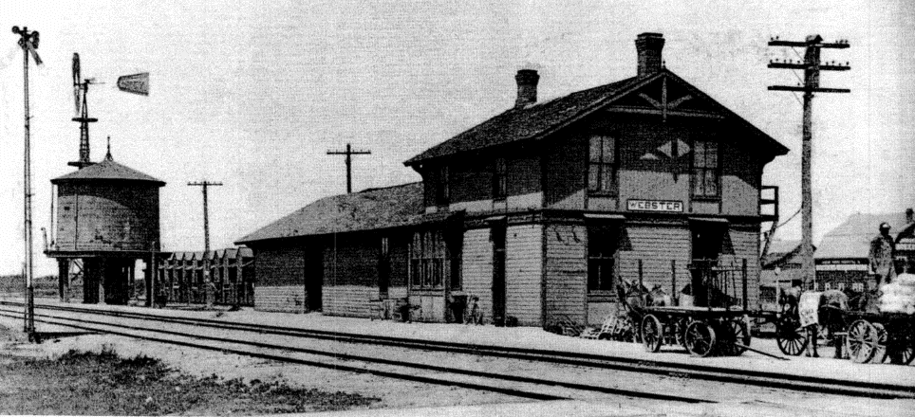
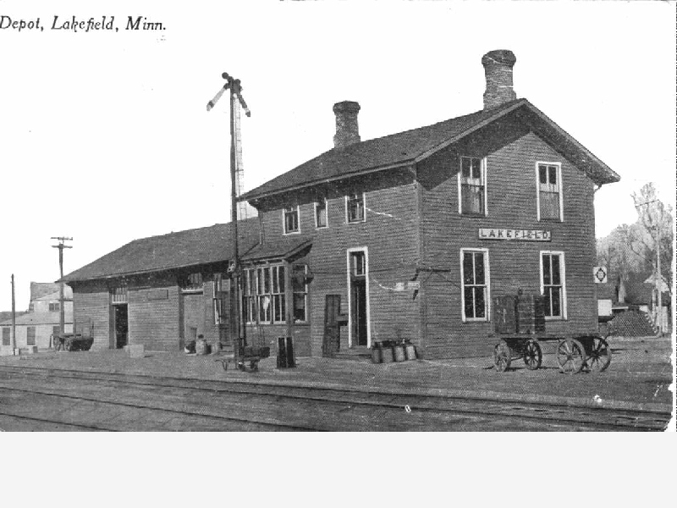
Predecessors of CP’s first standard station appeared on the Southern Minnesota RR in 1878 when Van Horne was its president.
Left: Lakefield MN. Right: Webster, Dakota Territory:
Lakefield
Webster

Slide 28
Variations in the standard design accommodated needs at different locations.
Note difference in window dimensions between the large (above) and small versions of the station.

Slide 29
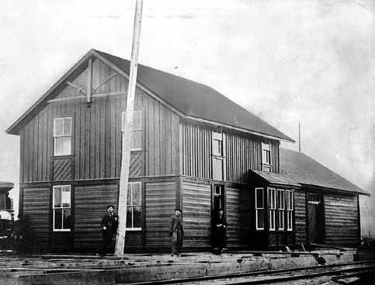
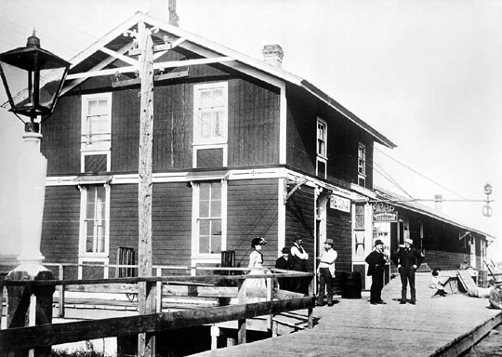
Regina Sudbury
Large versions of this station were built at major points

Slide 30
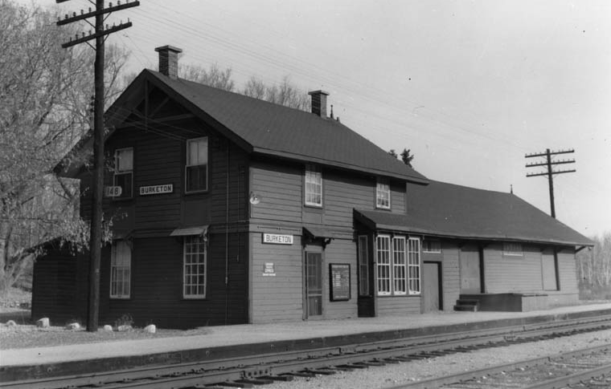
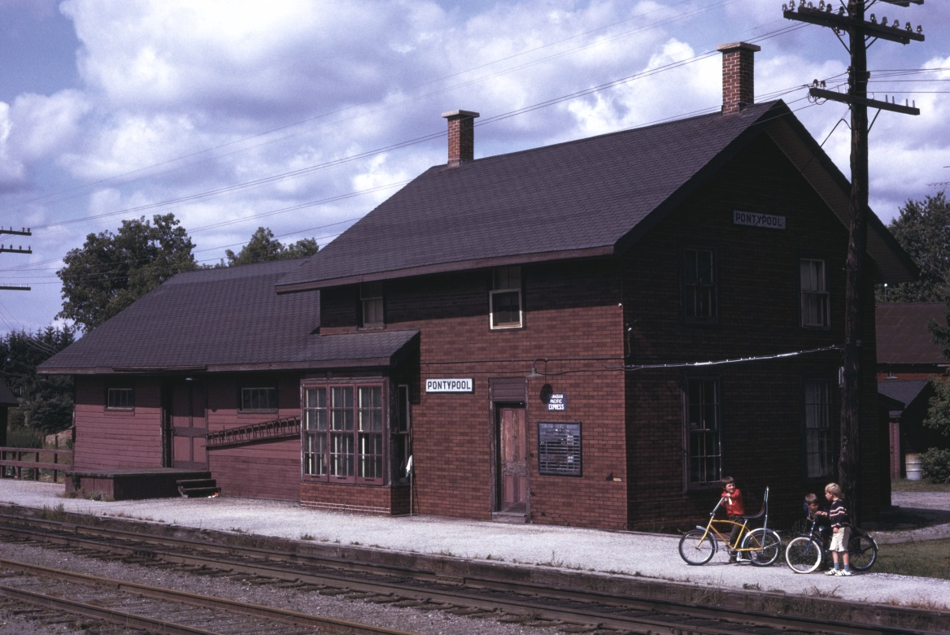
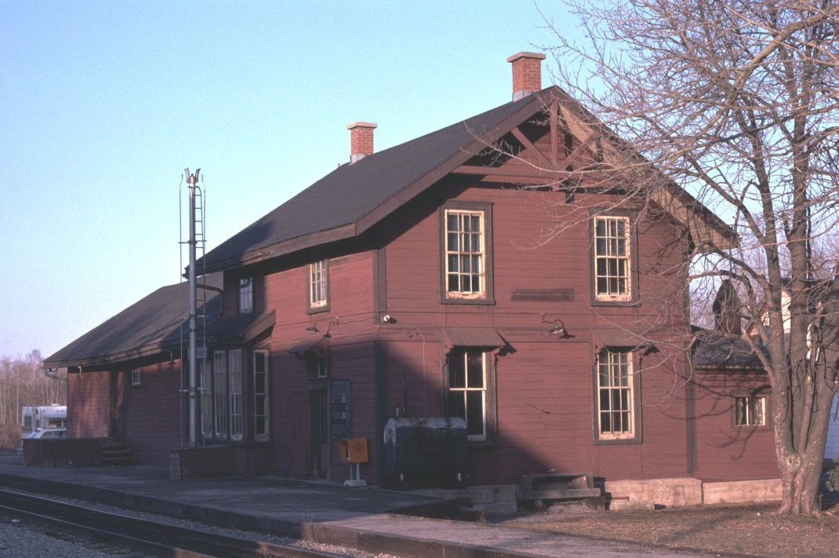
Many smaller Van Horne stations had uneven window sill heights facing the track.
Claremont station retained the original decorative woodwork on the end gable.
Burketon
Pontypool
Claremont

Slide 31
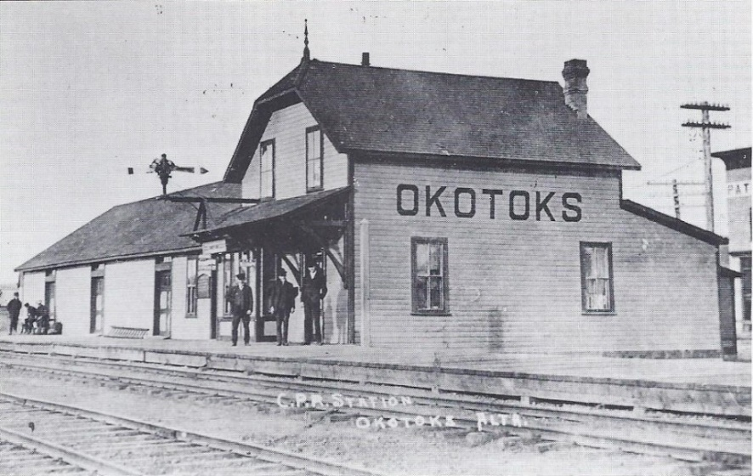
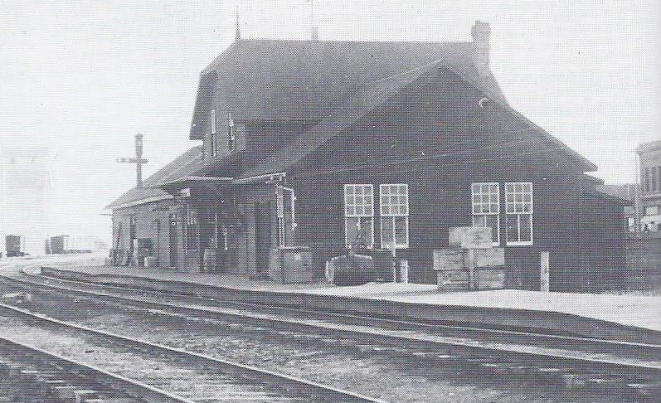
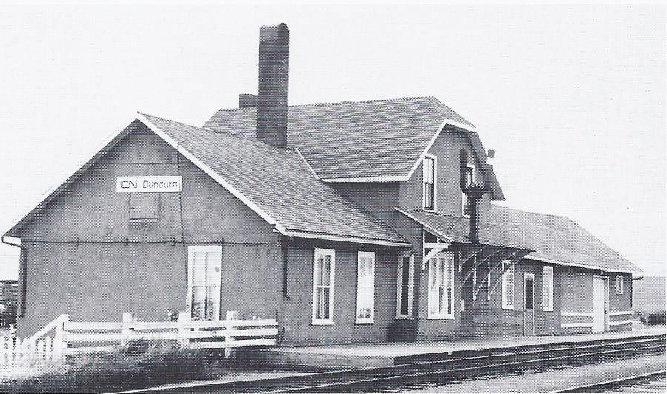
Type 2 Stations
52 were built during the 1890s and early 1900s, all but one on the Calgary & Edmonton and Qu’Appelle Long Lake & Saskatchewan Railways.
They had a main station and section house with a clipped gable facing the track, and a lower structure at one or both sides as needed.
Dundurn

Slide 32
Type 2 Stations
Many Type 2s were replaced by larger stations.
Dundurn station was a Type 2 on a line later transferred to Canadian Northern Railway. CN refinished it in stucco; uncommon on CP.
Dundurn

Slide 33
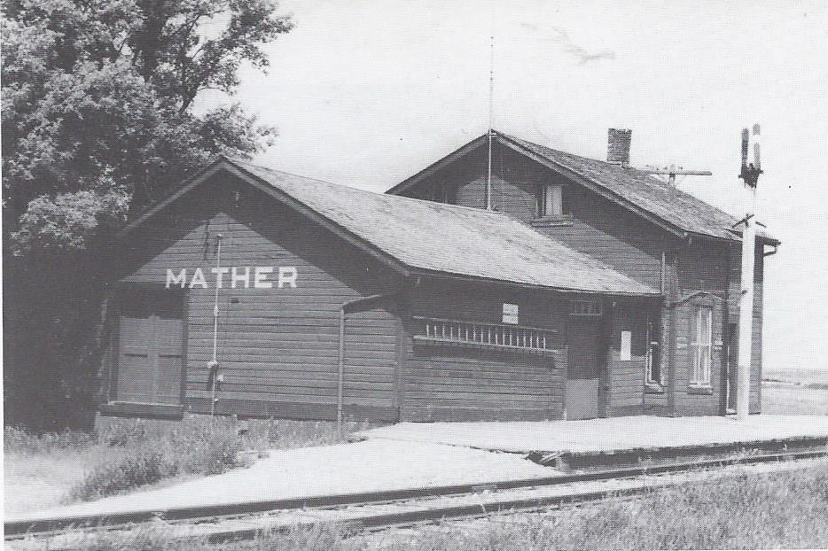
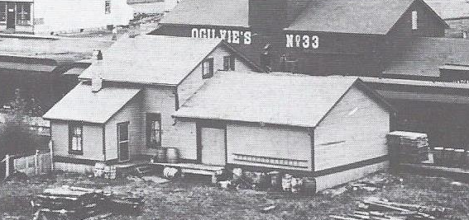
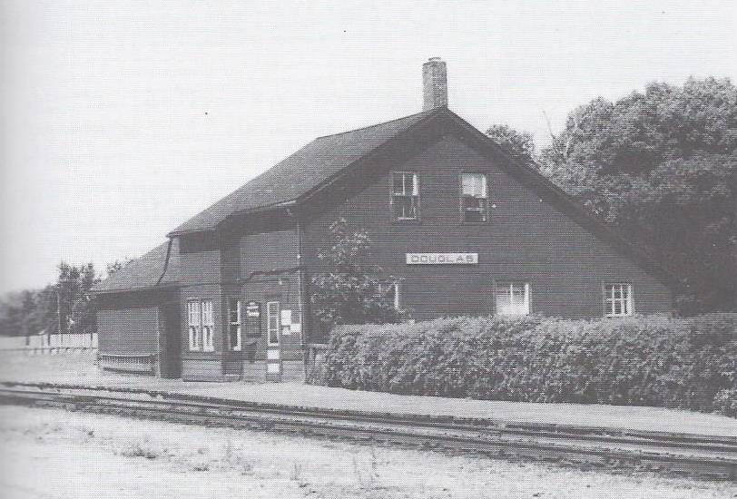
Type 4 Stations
Type 4 was a late variant of the Van Horne station, with a lower roof angle. Only 13 were built, all in Manitoba.
Thornhill has an annex added at the rear.
Douglas has a rear annex with a continuous roofline.
Thornhill
Douglas

Slide 34
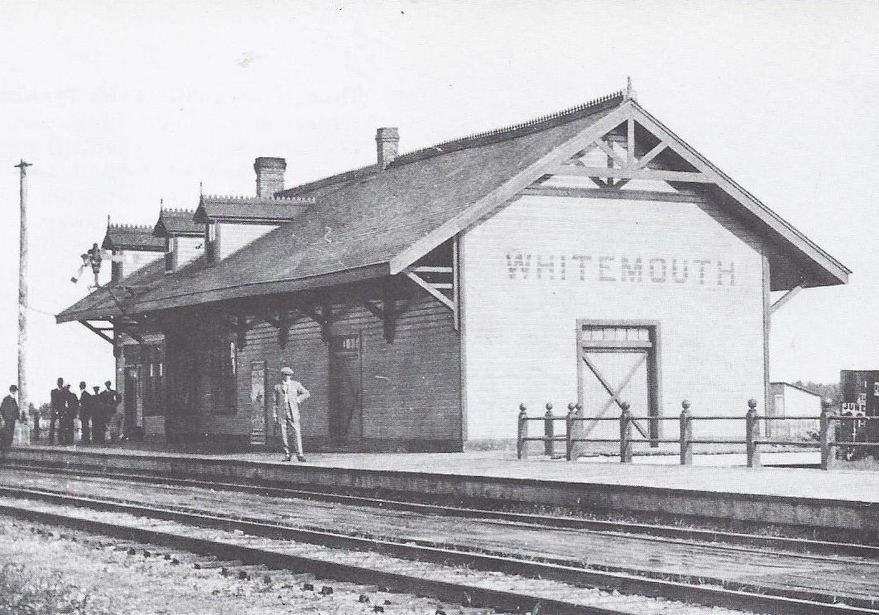
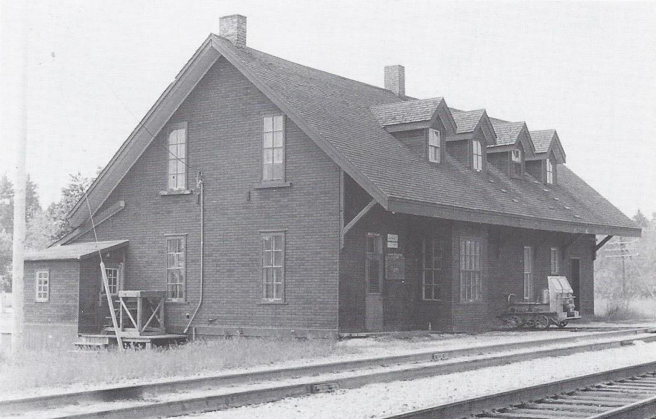
Type 5 Stations
The Government of Canada built 39 stations in Ontario, Manitoba and British Columbia on sections of the CP main line it constructed for the company.
Whitemouth MB shows an early CP colour scheme.
Eagle River ON has decoration removed, a rear annex with the roof extended down, and InsulBrick siding added to protect and insulate the building.
Whitemouth
Eagle River

Slide 35
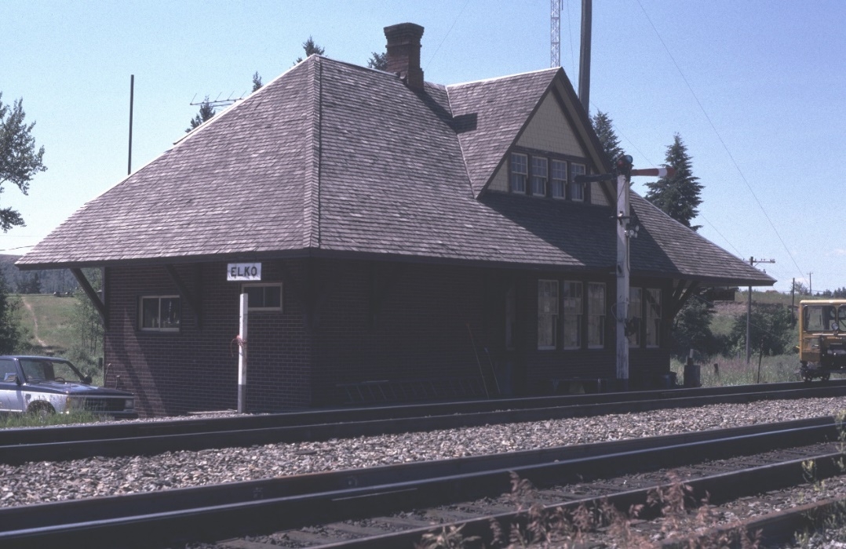
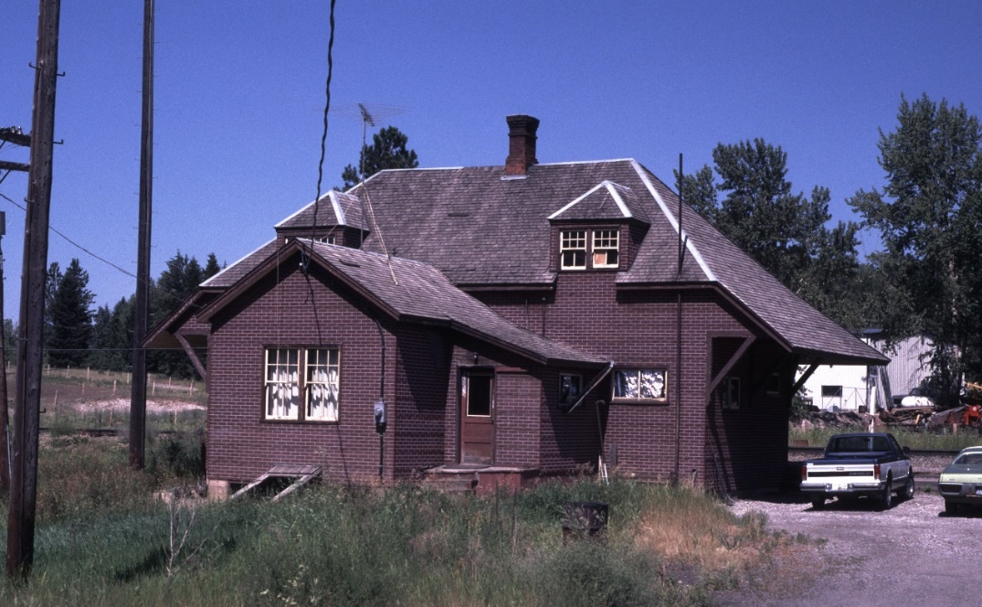
Type 6 Stations
13 of these simple but handsome “Crowsnest” stations were built in 1898 along the Crowsnest Pass line.
The Elko station shows the InsulBrick siding and rear annex added in later years.
Both changes were reversed when the building was moved to Cranbrook for preservation.

Slide 36
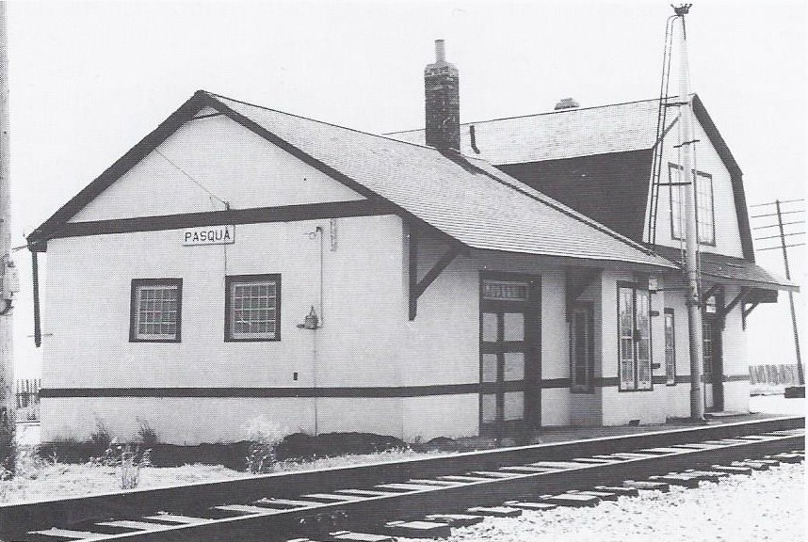
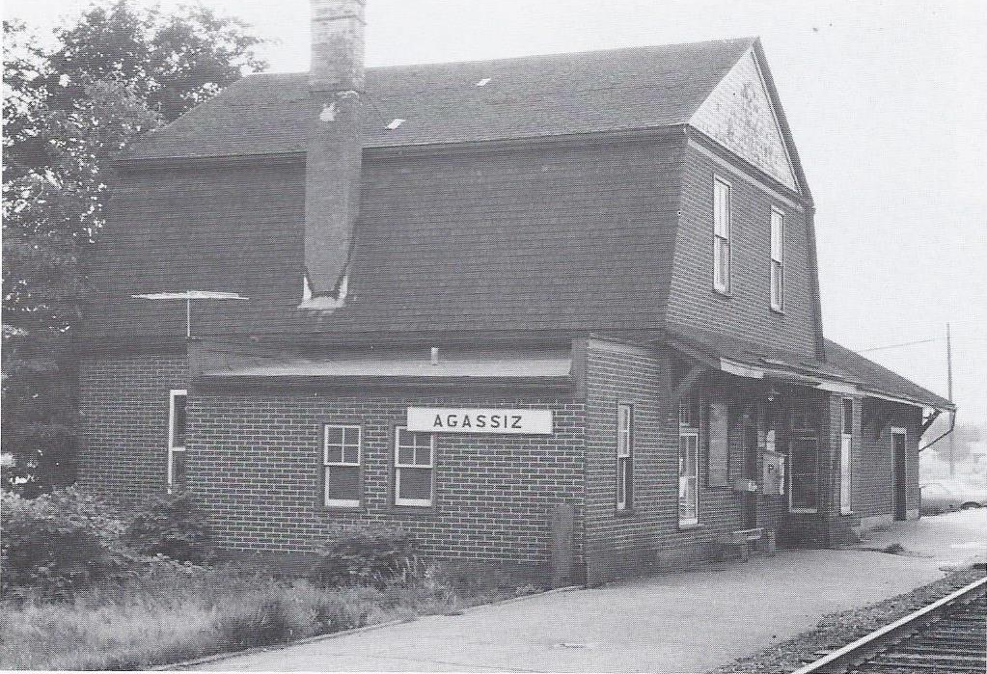
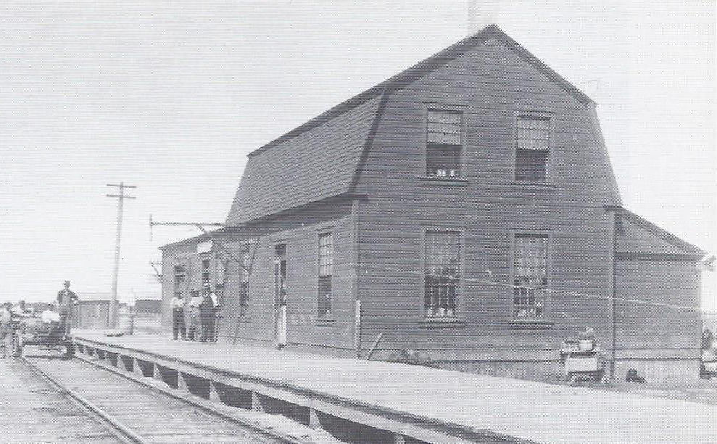
Type 7 Stations
CP’s first Gambrel roof stations. 17 built 1892-1903.
Pasqua SK station has stucco walls, rare on CP.
Agassiz BC station shows the addition of InsulBrick siding and a flat-roofed annex.
Tyndall and Telford MB had the Gambrel parallel to the track.
Pasqua
Tyndall
Agassiz

Slide 37
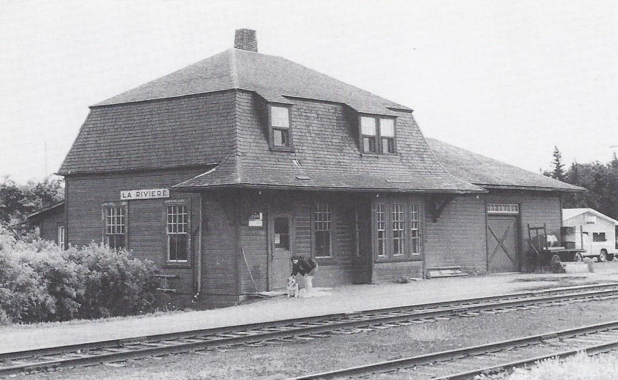
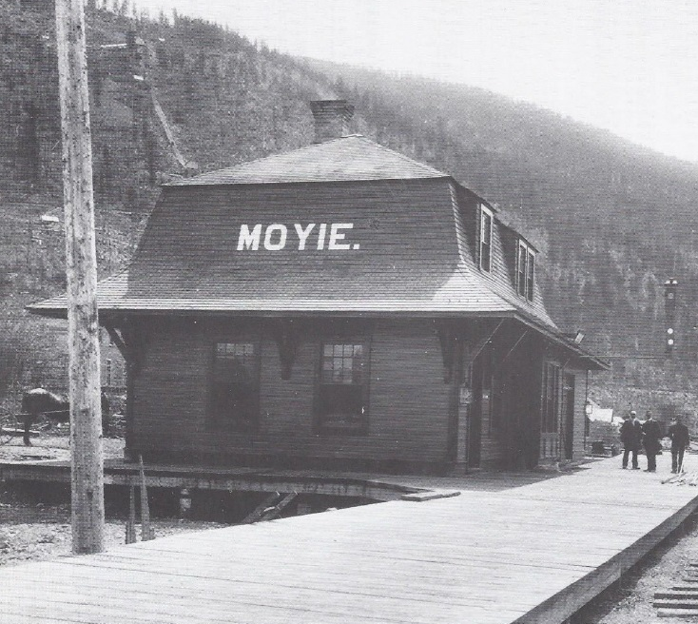
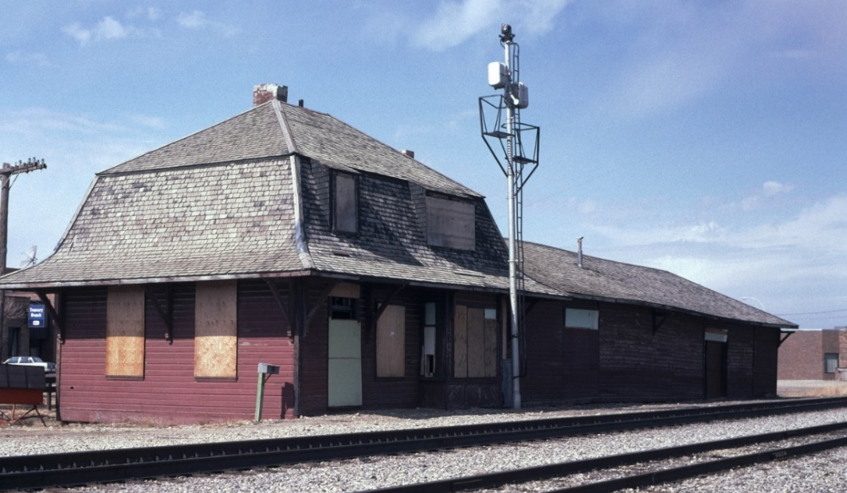
Type 8 Large Stations
Introduction of the Mansard roof on CP.
The large version has two dormers in front.
Note the variation in size of the freight sheds, and the cut-off eaves on La Riviere station.
Didsbury station has been restored, and rotated 180 degrees.
La Riviere MB
Didsbury AB

Slide 38
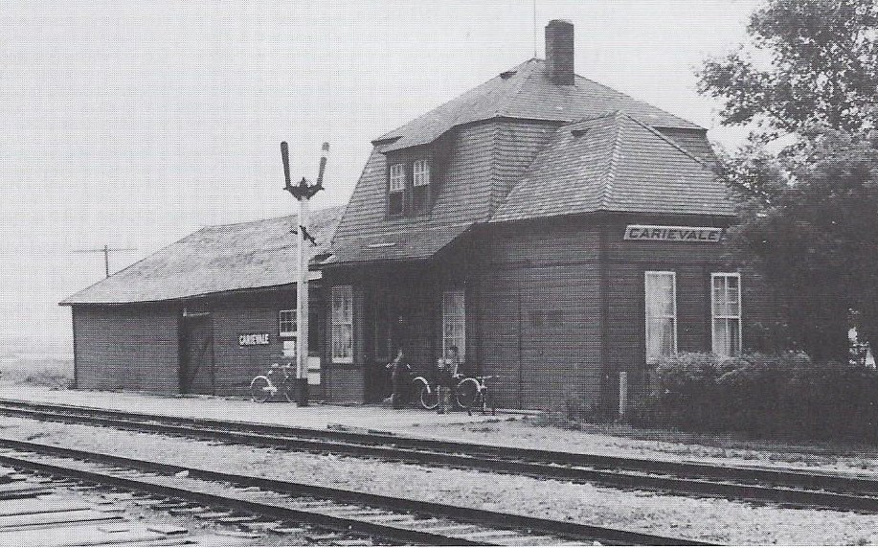
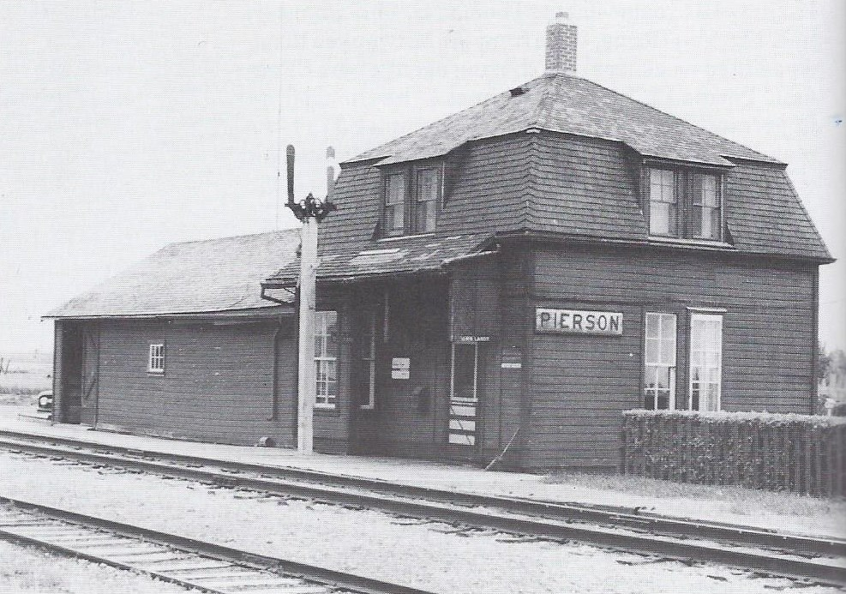
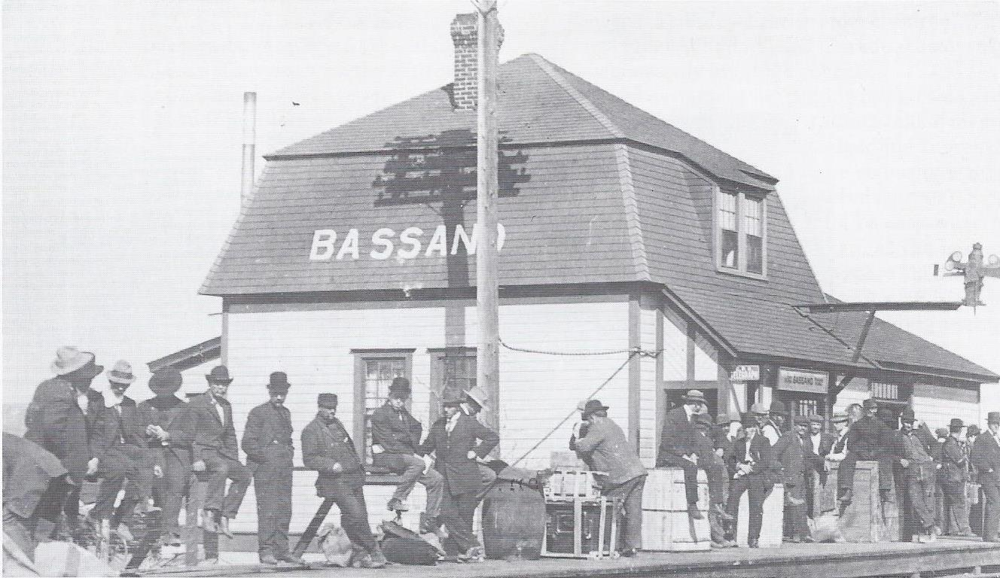
Type 8 Small Stations
Only one dormer facing the track, and prominent eaves on that side only. 28 built on Western Lines.
Different layouts for baggage and freight rooms.
Carievale station has an annex on the near end.
Bassano station was replaced by a much larger building when it became a junction.
Carievale

Slide 39
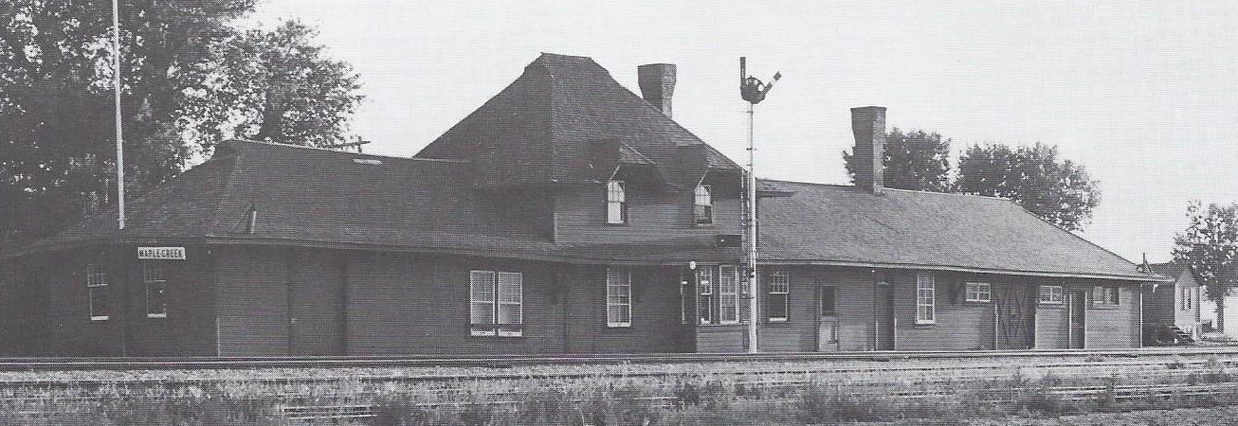
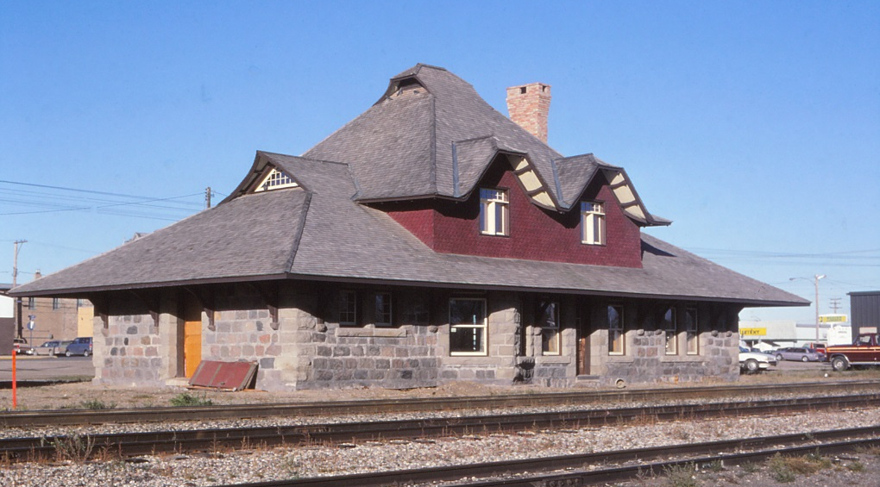

Type 9 Stations
Designed by architect Ralph Pratt.
Elaborate details made this design too expensive for CP’s new president Thomas Shaughnessy.
Maple Creek
Virden
Carberry

Slide 40
Type 9 Stations
Maple Creek was greatly extended.
Virden is a variant with stone construction.
Carberry had a half-timbered upper storey.
Maple Creek
Virden
Carberry

Slide 41



Type 10 Stations
24 built, most between 1903 and 1906. CP called this Western Lines Standard No. 2 Station.
Simpler hipped roof extending over the platform on brackets to protect passengers.
Hipped dormer facing tracks serves two rooms.
Each has a different baggage room configuration.
Ignace
Rocanville
Lipton

Slide 42
Type 10 Stations
Ignace has work space for terminal purposes.
Reduced roof overhang
Different waiting room window arrangement
Asbestos cladding has been added.
Ignace
Rocanville
Lipton

Slide 43



Eastern Type 10 Stations
Some Type 10 stations were built on Eastern Lines. There were many differences among them:
Port McNicoll ON has a large waiting room.
Blyth ON contains freight and express facilities.
Beaconsfield QC, is a commuter station with a surprisingly small waiting room and large freight shed.
Port McNicoll
Blyth
Beaconsfield

Slide 44



Type 11 Stations
One-story stations without living quarters were uncommon on Western Lines.
22 of Type 11 stations were built between 1903 and 1950. They could be expanded to meet local traffic needs.
Oliver BC station has been preserved as a Visitor Centre.
Crossfield
White Fox
Oliver

Slide 45


Type 12 Large Station
CP called this the Standard No. 10 station. Many were built in the years before the First World War, in both east and west.
Distinguished from the smaller variant by widely separated upper story windows, and a length of 73 feet rather than 50.
Barons (top) and Bassano as built were typical of this type.
Due to its location at an important junction, the needs of traffic and maintenance saw Bassano station grow to an extreme length.
Barons

Slide 46



Type 12 Small Station
CP called this the Standard No. 5 station.
Taber and Brooks AB and Mont Laurier QU were built 25 feet longer with an additional dormer.
Burwash ON lacked a long freight shed.
Bow Island had narrower upstairs windows than most others of its type.
Taber
Burwash
Bow Island

Slide 47




Coaldale
Type 13 Stations
Type 13 was built 1908-1918, overlapping with Type 12. It was simpler with a more modern look.
Coaldale (above) had a short shelter facing the track. Manyberries had a wraparound shelter.
Dunmore had the operator’s bay on the baggage shed.
Manyberries
Dunmore

Slide 48



Type 14 Stations
Between 1908 and 1912, CP built eight stations at division points and major junctions on secondary main lines. All featured a high gabled roof, crossing a main hipped roof.
Locations not shown here were Assiniboia, Kerrobert, and Outlook SK, and Coronation and Hardisty AB.
Colonsay
Wilkie
Kerrobert

Slide 49



Type 15 Stations
New designs were developed for renewed western branch line construction during 1920s.
Type 15 resembled the prewar Type 13 but with a prominent front dormer projecting beyond the side walls. The rear dormer is smaller, as at Wadena SK.
Napinka
Wadena

Slide 50



Type 16 Stations
Type 16 was a cheaper alternative to Type 15, with fewer rooms upstairs.
The main roof was hipped with a transverse gabled upper story, making a plain but handsome design.
Dawson Creek BC on the Northern Alberta Railways had a long extension for freight and express.
Andrew
Dawson Creek
Willingdon

Slide 51




Mossleigh
Portable Stations
Portable stations were designed to be moved on a flatcar. They were not rebuilt from boxcars.
They could be found with sheds and other buildings
Two Hills
Yale
Hobbema

Slide 52



Major Stations on the North Line
Minnedosa, Bredenbury and Yorkton stations are on the former Manitoba & North Western Railway, part of CP’s Winnipeg to Edmonton North Line. Oak Lake MB station was similar.
They have three dormers on each side, the centre one being larger.
The ends of their roofs are reminiscent of the Type 9 stations found at Virden and elsewhere.
Bredenbury
Minnedosa
Yorkton

Slide 53


Macleod
Macleod and Cranbrook
Cranbrook station was originally similar to Macleod, until the top story was raised and another built in between!
Cranbrook

Slide 54



Turreted Stations
Lethbridge, Medicine Hat and Red Deer stations resembled Macleod and Cranbrook but with a turret in the middle.
They were the same size when built.
Each was enlarged significantly to serve growing traffic.
Lethbridge
Medicine Hat
Red Deer

Slide 55



Turreted Stations
Lethbridge, Medicine Hat and Red Deer stations resembled Macleod and Cranbrook but with a turret in the middle.
They were the same size when built.
Each was enlarged significantly to serve growing traffic.
Lethbridge
Medicine Hat
Red Deer

Slide 56



Turreted Stations
Strathcona (South Edmonton) and Saskatoon had a wider turret with a lower roof than the earlier stations at Red Deer, Lethbridge and Medicine Hat.
They were alike when built, but Saskatoon station (below) was extended significantly.
Strathcona
Saskatoon

Slide 57
Thank you for watching this presentation.
We hope you enjoyed it as much as we enjoyed creating it.
Please stand by for the next presentation.

